Slide 1

Employee Retention and Turnover in Global Software Development:: Comparing In-house Offshoring and Offshore Outsourcing
SAMAN BIBI
BSCS-F19-M47
MAM AYEHSA
SPM

Slide 2


INTRODUCTON
Employee Retention and Turnover
In-house Offshoring
Offshore Outsourcing

Slide 3

BACKGROUND
NAME | YAER | PROBLM | METHOD | CONCUSION
David Wilson | April 2008 | Impact of staff turnover on software projects | empirical study of 89 software practitioners | Improving motivation levels can reduce staff turnover, which in turn increases project success.
Abdel-Hamid | 22 Dec 2015 | staff turnover, acquisition, and assimilation rates affect software development cost and schedule | A system dynamics model of the software development process is employed as our experimentation | results indicate that staff turnover, acquisition, and assimilation rates can increase a project’s cost and duration by as much as 40 to 60 percent

Slide 4
NAME | YAER | PROBLM | METHOD | CONCUSION
Jhon Noll | 2017 | effect of global software development on motivation. | Scrum approach | autonomy is a necessary but not sufficient condition for motivation among experienced team members, and (2) autonomy is not a motivator unless accompanied by sufficient competence.
Bin lin | 2017 | Developer turnover in global, industrial open source projects | Five open source projects | start contributing to the project earlier; 2) mainly modify instead of creating files; 3) mainly code instead of dealing with documentations
Tore Dybå | 2010 | we perform a tertiary review to assess the types and methods of research synthesis in systematic reviews in software engineering. | Literature review | The results show that, despite the focus on systematic reviews, there is, currently, limited attention to research synthesis in software engineering. This needs to change and a repertoire of synthesis methods needs to be an integral part of systematic reviews to increase their significance and utility for research and practice.

Slide 5


METHODOLOGY
The research employed a mixed-method approach comprising two empirical case studies in industry involving 62 practitioners at three international companies conducting in-house and offshore outsourced software development.

Slide 6


DISCUSSION
In Case Study A, 53 practitioners were interviewed to compare and contrast the in-house offshore setting (an offshore development center that is part of a larger international company) and an offshore outsourcing service provider.
In Case Study B, a participant observation study was conducted over a 14 month period. A geographically distributed team was investigated in-depth, including interviews with 9 of its members.

Slide 7

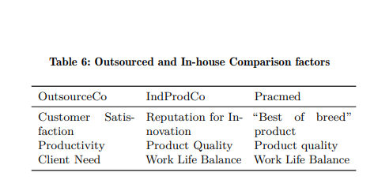

DISCUSSION

Slide 8


We speculate that offshore outsourcing service providers could reduce staff member turnover by improving work-life balance and adopting more family friendly employment policies. Further, outsourcing service providers could reward innovation more effectively and structure contracts to enable software product ownership to improve staff retention.

Slide 9


